Slide 1


PROJECT MANAGEMENT PRINCIPLES AND PRACTIES
MS-PM-Spring 2025
Lecturer
Sajid Mehmood

Slide 2
LECTURE OUTLINE
Scope Management
The Importance of Scope Management
Conceptual Development
The Statement of Work
The Project Charter
Defining the Project Scope
Establishing Project Priorities.
Creating the Work Breakdown Structure.
Integrating the WBS with the Organization.
Coding the WBS for the Information System.
Process Breakdown Structure.
Responsibility Matrices.
Project Communication Plan.

Slide 3
BUSINESS CASE
Business Case:
  Business case provides justification for undertaking a project, programme or portfolio. It evaluates the benefit, cost and risk of alternative options and provides a rationale for the preferred solution.
Preparing the business case involves an assessment of:
  Business problem or opportunity.
  Benefits.
  Risk.
  Costs including investment appraisal.
  Technical solutions.
  Timescale.
  Impact on operations.
  Organizational capability to deliver the project outcomes.

Slide 4
BUSINESS CASE EXERCISE
"Strategies for Launching a New Smartphone in a Competitive Market"
"Introducing a Health and Wellness App to the Market"
"Launching an Eco-Friendly Cleaning Product Line"
"Bringing a Luxury Watch Collection to Market"
"Introducing a Plant-Based Protein Beverage to Consumers"
"Market Entry Plan for a New Electric Car Model"
"Launching a Line of Sustainable Fashion Products"
"Introducing a Premium Coffee Subscription Service"
"Bringing a Smart Home Automation Device to Market"
"Market Entry Strategies for a New Organic Skincare Line"
"Marketing the UVW Virtual Reality Gaming Console: A Campaign Plan“
"Introducing a Cutting-Edge Home Fitness Equipment Line to Consumers"

Slide 5
Project Charter
The very first thing that’s done on a new project is the development of the project charter. That’s the document that authorizes you to do your work. But you’re not always involved in making it—oftentimes it’s handed to you by the sponsor.
Project Charter process tells everyone in the company why the project is needed, and gives you the authority you need to make it happen.
Inputs for Develop project charter:
Agreement
EEF
OPA
Business case Output:
Tools: Project charter
Expert judgement Assumption Log
Data Gathering

Slide 6
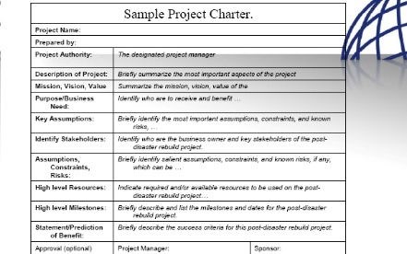
Project charter Include
Project description
Project goals
Project scope
Project milestone(DMAIC)
Project Manager and Authority
Business case

Slide 7
Plan your project!
Planning the project is when you really take control. You write a plan that says exactly how you’re going to handle everything that goes on in the project. The Develop Project Management Plan process is where you organize all of the information about your project into one place, so everyone knows exactly what needs to happen when they do the project work—no matter what their jobs are.
The Direct and Manage Project Work process
Once you have a Project Management plan, your project is ready to begin. And as the project unfolds, it’s your job to direct and manage each activity on the project, every step of the way.

Slide 8
The Manage Project Knowledge process
The whole time your project is happening, your team is solving problems and learning. The Manage Project Knowledge process is all about using the information your company has already learned from doing past projects and creating new information when your team learns something your company hasn’t encountered before.
Look for changes and deal with them
Finish the work, close the project

Slide 9
Scope management: Doing the right stuff
Product scope: Features and functions of the product that you and your team is going to build
Project scope :all of the work that need to be done to make the product.
Scope Creep : those uncontrolled changes that cause the team to do more work
Scope Management means figuring out what’s OUT OF scope, not just what’s part of it.

Slide 10
Six Scope Management processes
Each of the Scope Management processes was designed to help you avoid the kinds of scope problems that cause a lot of projects to go off track
1.Plan scope management process
2. Collect requirements
3. Define scope
4. Create WBS
5. Control scope
6. Validate Scope

Slide 11
Plan Scope Management process
It is where you lay out your approach to figuring out what work you’ll do and what’s out of scope. All of the other processes in the Scope Management knowledge area are defined and described in this document.
Input : OPA, EEF , Project Plan, Project Charter
Tools: Expert judgement , Meetings , data analysis
Outputs: Scope Management plan and the Requirements Management plan.

Slide 12
The Scope Management plan
The Scope Management plan keeps you on track by detailing the processes you and your team will follow as you document your scope, figure out your work breakdown structures, and validate and control your scope for the rest of the project.
The Requirements Management plan
The Requirements Management plan details the process you’ll use to collect requirements and how you’ll manage them once they’ve been written down.

Slide 13
Collect requirements for your project
sitting down with all of the stakeholders for your project and working out what their needs are.
Inputs: EEF, OPA, Project Management Plan, Business documents, Project charter
Tools: data gathering
Output: requirements document

Slide 14
Define the scope of the project
They contain everything you need to know before you can begin to break the project down into the work that the team members will do.
Inputs: OPA, EEF, Project Management Plan , Project charter, Business plan
Tools : data gathering
Output: project scope statement

Slide 15
Project Scope
A definition of the end result or mission of the project
A product or service for the client/customer—in specific, tangible, and measurable terms.
• Purpose of the Scope Statement
To clearly define the deliverable(s) for the end user.
To focus the project on successful completion of its goals.
To be used by the project owner and participants as a planning tool and for measuring project success.

Slide 16
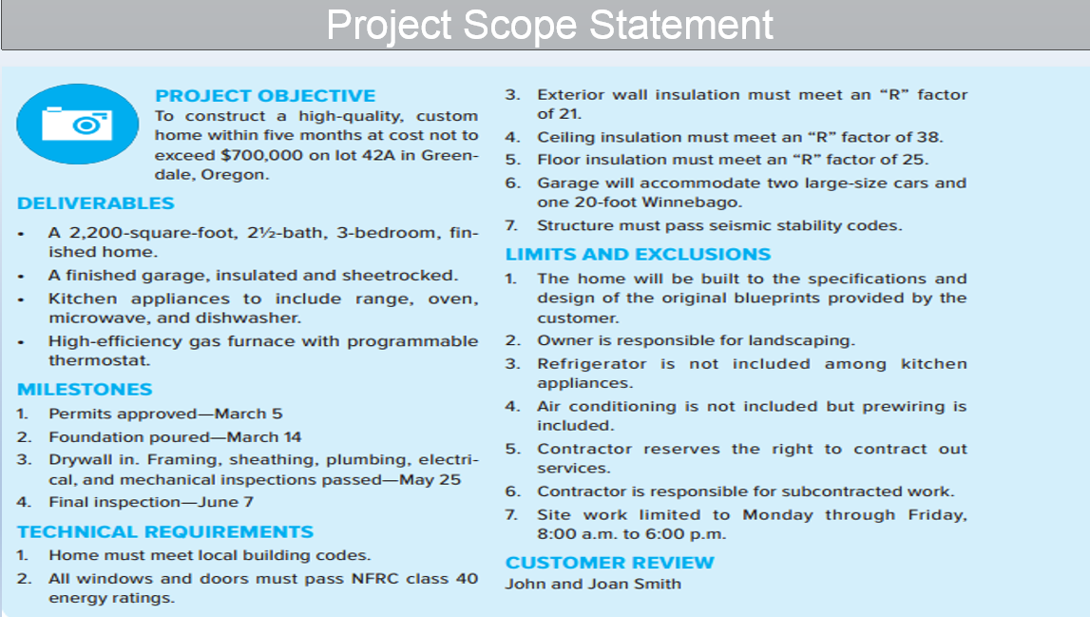

Slide 17
What Is An SOW?
A formal written description of your minimum requirements to be performed by a contractor
The “heart of your procurement”
Notes:
SOWs must reflect the full requirement to include a description of the work to be accomplished, the outcomes or deliverables, any NAFI/Government information to be provided the contractor, All other documents must be consistent with your SOW. We will go into this a litlle later, however some examples are the evaluation factors/criteria, instructions for proposal presentation,

Slide 18
Why is a Clear and Concise
SOW Important ?
Provides a clear understanding of the requirements
Establishes a baseline for proposal evaluation
Reduces evaluation and negotiation time
Minimizes need for future changes
Baselines contractor performance measures
Notes:
Amendments during the solicitation and evaluation process
Ensures ease of administration – lessens possibility of misinterpretations of requirements.
Additional cost as a result of inadequate specification

Slide 19
STATEMENT OF WORK
PROCESS OVERVIEW
The following is a summary of the recommended process steps for preparing a Statement of Work SOW :
Establish a preliminary scope statement ( i.e., the purpose or objective of your procurement)
List the tasks to be performed ( i.e., All performance requirements you intend the contractor to satisfy, all requirements that the contractor must comply with during contract performance )
Group similar and related tasks.
Organize the tasks in logical sequence
Identify the input ( Required resources to perform the tasks)
Identify the output ( Required results or deliverables )
Identify the timeline or frequency of the deliverables (output)
Develop the parameters for acceptable quality and performance
Determine how you will monitor the deliverables

Slide 20
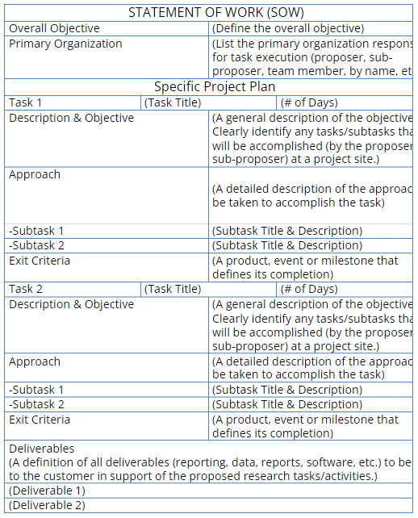

Slide 21
Responsibility Matrix
A responsibility assignment matrix (RAM) in project management, also known as a RACI chart or RACI matrix, details all the necessary stakeholders and clarifies responsibilities amongst cross-functional teams and their involvement level in a project. RACI stands for Responsible, Accountable, Consulted, and Informed and each letter corresponds to a team member.
A RAM in project management should be referred to by all parties throughout a project because it helps plan an individual’s roles and responsibilities before work begins. A RACI matrix ensures all stakeholders know who is responsible for completing a task or getting feedback on deliverables.
The roles are broken down as follows:
Responsible: The person(s) completing the task
Accountable: The team member coordinating the actions, making decisions, and delegating to those responsible for the task
Consulted: The person(s) who will be communicated with regarding decisions and tasks

Slide 22
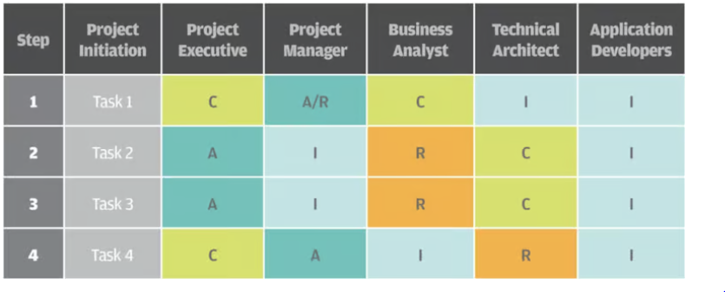
Responsibility Matrix

Slide 23
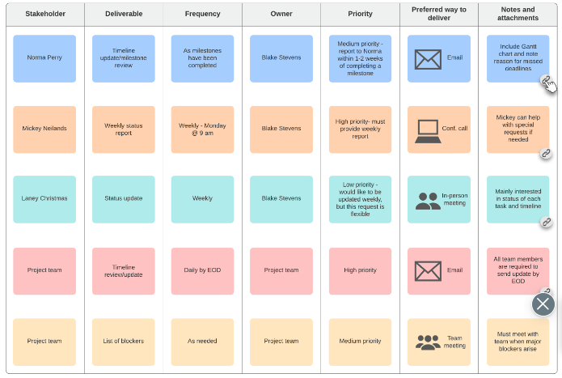
Project Communication Plan
A project management communication plan identifies how important information will be communicated to stakeholders throughout the project. It also determines who will be receiving the communication, how those people will receive it, when they’ll receive it, and how often they should expect to receive that information.

Slide 24
Create the work breakdown structure
The Create WBS process is the most important process in the Scope Management knowledge area because it’s where you actually figure out all the work you’re going to do. It’s where you create the work breakdown structure (or WBS), which is the main Scope Management output. Every single thing that anyone on the project team—including you— will do is written down in the WBS somewhere.
Input: EEF , OPA , PMP, Scope management Plan Requirements documentation.
Tools : Decomposition -Break it down by project or phase
Output: WBS

Slide 25
The WBS decompose the entire scope of the project into manageable components that is required in detailed schedule planning to execute the work needed to accomplish the project.
Work Package is the lowest level of WBS in which activities are defined with assigned durations, resources and constraints to develop deliverables.

Slide 26

WBS is deliverable oriented hierarchical decomposition of total scope of work to be carried out by the project team to accomplish the project objectives and create required deliverables.
It doesnot actually involve breaking down work , it involves breaking down deliverables.

Slide 27
The upper levels of WBS typically reflects the major deliverable work areas of the project the lower WBS elements provide appropriate details and focus for support of project management processes Eric S Norman PMI
WBS doesn't describe any actions. Instead, every item is a noun describing an end product - a bicycle seat, fork, handlebar, etc. This is one of the fundamental features of a WBS: it describes deliverables, not the activities necessary to get there.

Slide 28
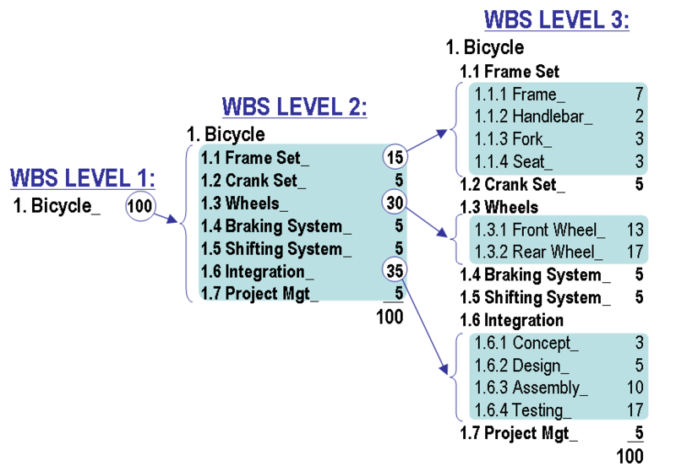

Slide 29
Additional Definitions
Work:
According to PMBOK, work refers to “work products or deliverables that are the result of effort and not the effort itself”.
That is, “work” defines the end result of any activity.
The work remains constant even though the amount of effort needed to get there might inflate/deflate.

Slide 30
Deliverable:
PMBOK says that a deliverable is “any unique and verifiable product, result, or capability to perform a service that is required to be produced to complete a process, phase, or project”.
Deliverables will vary from project to project and client to client.
Work package:
According to PERT (which developed the WBS), a work package is “the work required to complete a specific job or process, such as a report, a design, a documentation requirement or portion thereof, a piece of hardware, or a service.”
PMBOk has a simpler definition: “a work package is a deliverable at the lowest level of the WBS.”

Slide 31
Characteristics of the Work Breakdown Structure
Not every breakdown of project deliverables can be classified as a WBS. For it to be called a work breakdown structure, it must have certain characteristics:
Hierarchy: The WBS is hierarchical in nature. Each “child” level exists in a strict hierarchical relationship with the parent level. The sum of all the child elements should give you the parent element.
100% rule: Every level of decomposition must make up 100% of the parent level. It should also have at least two child elements.
Mutually exclusive: All elements at a particular level in a WBS must be mutually exclusive. There must be no overlap in either their deliverables or their work. This is meant to reduce miscommunication and duplicate work.
Outcome-focused: The WBS must focus on the result of work, i.e. deliverables, rather than the activities necessary to get there. Every element should be described via nouns, not verbs. This is a big source of confusion for beginners to WBS.

Slide 32
Why WBS is important?
WBS is a pictorial representation of scope; it represents total scope of work. A picture is worth thousand words and hence easy to understand & follow.
WBS represents total scope and hence it can act as a checklist for the project. A PM can easily tell what all has been accomplished and what is remaining in the project.
Each successive level of WBS provides a basis for more accurate estimation of effort, duration, resources and cost.
The deliverable, as represented by WBS, can be easily monitored and tracked.
Historical WBS can act as a templates for future work – specifically for some repetitive processes. It results in easier and faster project planning.
Smaller work can be easily assigned to individual team members and they can be made accountable.
Most important it reduces the project risk.

Slide 33
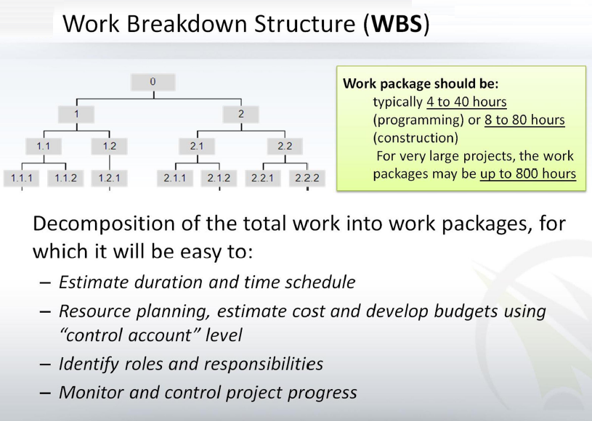
.

Slide 34
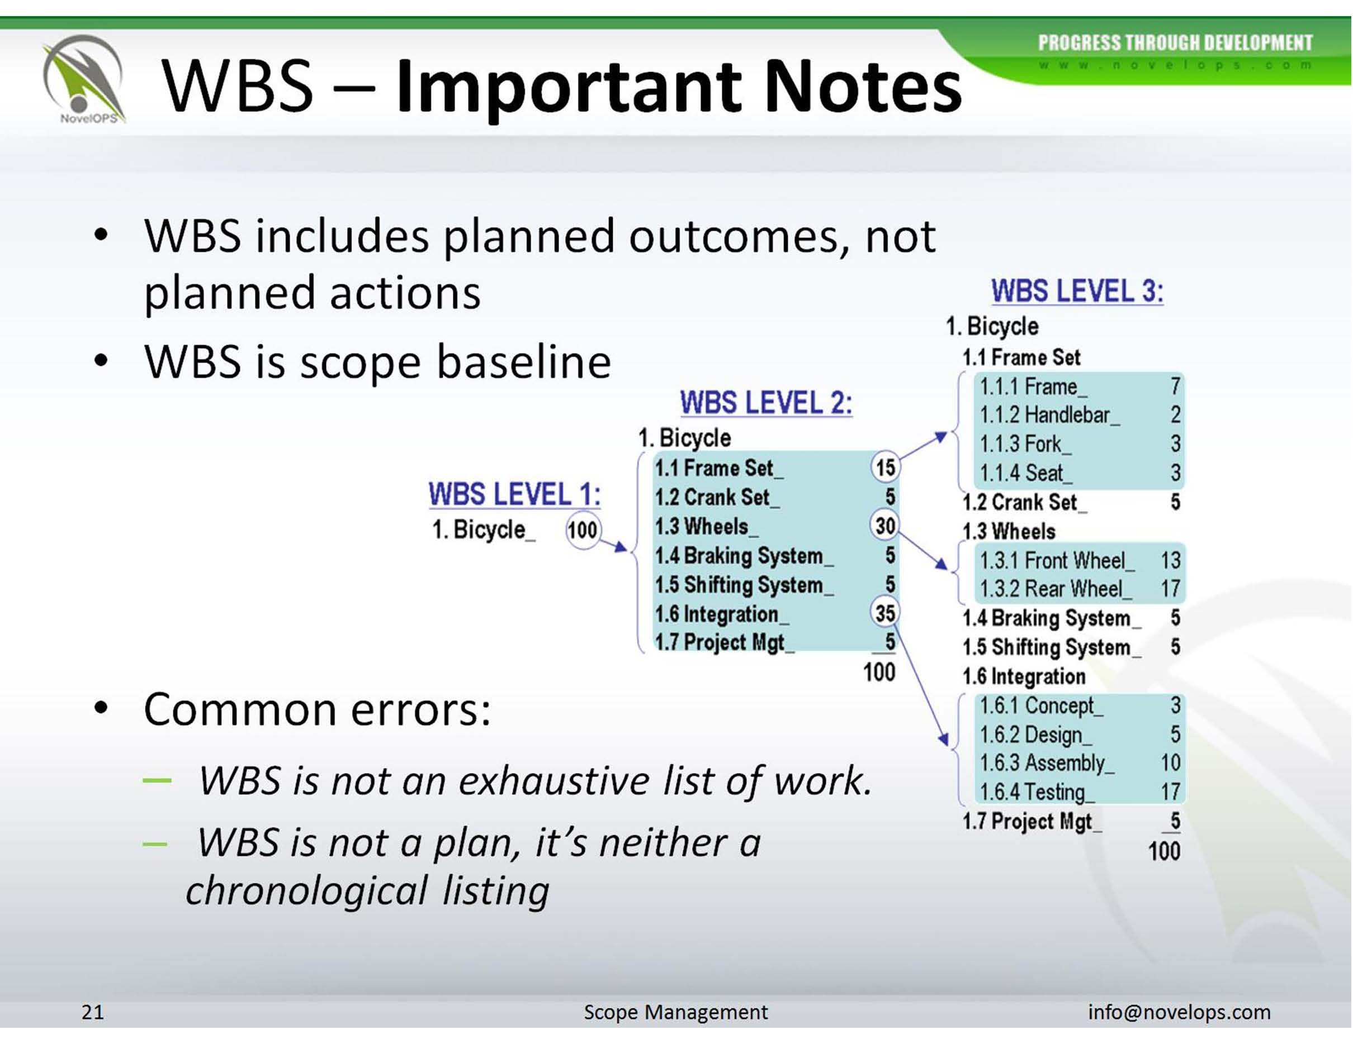

Slide 35
How to Create a WBS
. To create it, however, you need a thorough understanding of the project’s scope, your team’s capabilities, and your stakeholders’ requirements.
Understand the Project’s Scope
You need two things : Project scope statement to understand the project’s scope in detail.
Project scope management plan to understand how to deal with changes to the project’s scope (which will affect your deliverables).You’ll want to refer to your project charter to develop the scope statement and scope management plan.

Slide 36
2.Determine Major Deliverables
Once you have an understanding of the project scope, start the WBS development process by figuring out the key deliverables.
There are two heuristics you can follow for determining major deliverables at the 2nd level:
Each deliverable must be essential to the success of the project.
Each deliverable should be the responsibility of an independent team.

Slide 37
3. Determine Work Packages
A work package, as you learned above, is a deliverable at the lowest level of a WBS.
Your goal is to pick a major deliverable, then identify all the work necessary to complete it.
complete it.
This work package must be:
Independent
Definable
Manageable
Adaptable
8/80 rule
Reporting period
Use nouns:

Slide 38
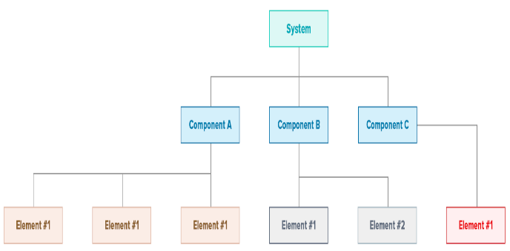
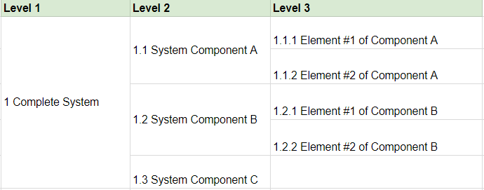
. Use the Right WBS Format
Once you have all the work packages and WBS dictionary, it’s time to create the WBS.
There are several WBS formats you can follow. The simplest way to do this is to create text-based hierarchical groupings. By convention, you use numbers and decimal points to indicate the level of the element.

Slide 39
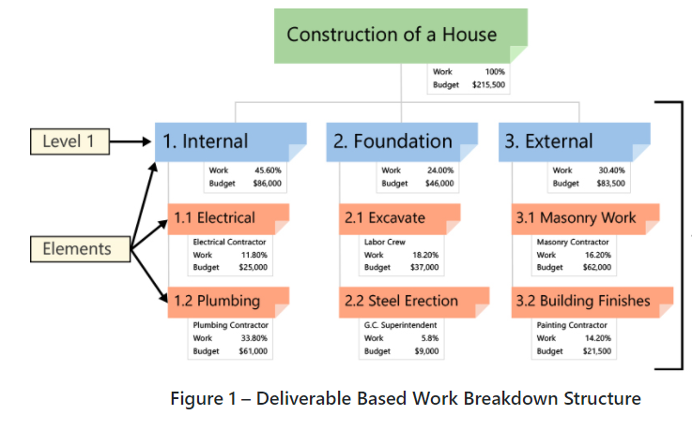
Deliverable-Based Work Breakdown Structure

Slide 40
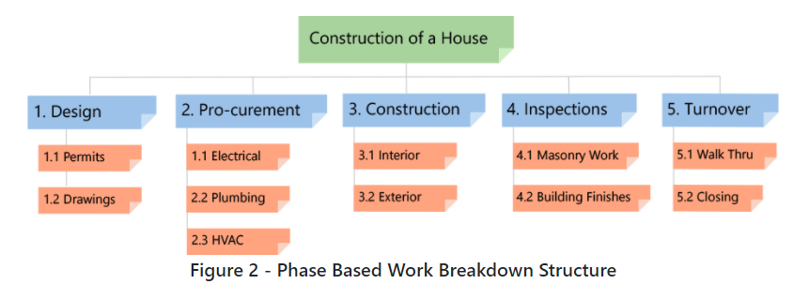
Phase-Based Work Breakdown Structure

Slide 41
WBS dictionary
The WBS dictionary is an important output of the Create WBS process—the WBS wouldn’t be nearly as useful without it.
The WBS dictionary contains the details of every work package. It’s a separate output of the Create WBS process

Slide 42

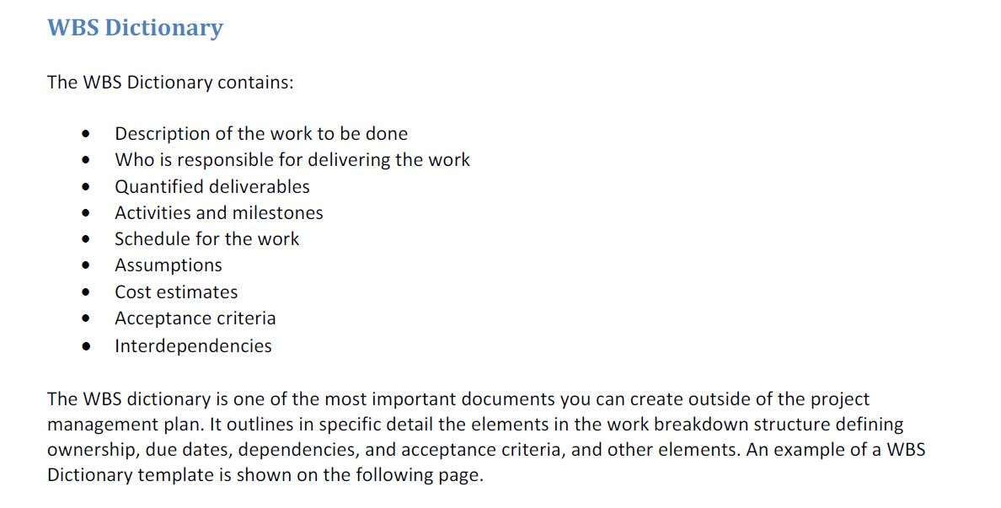
.

Slide 43
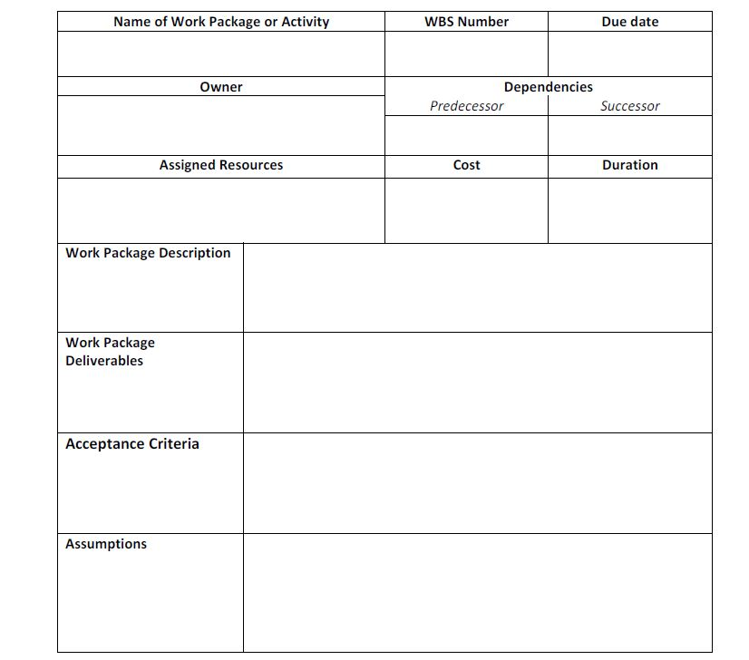
WBS DICTIONARY TEMPLATE

Slide 44
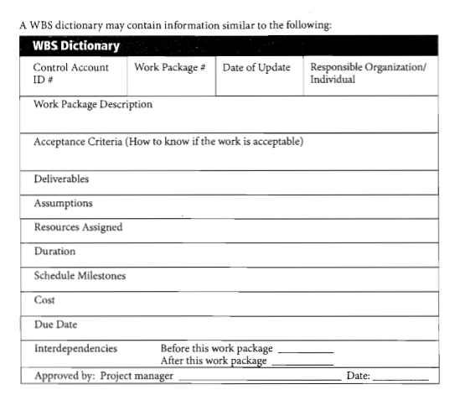

Slide 45
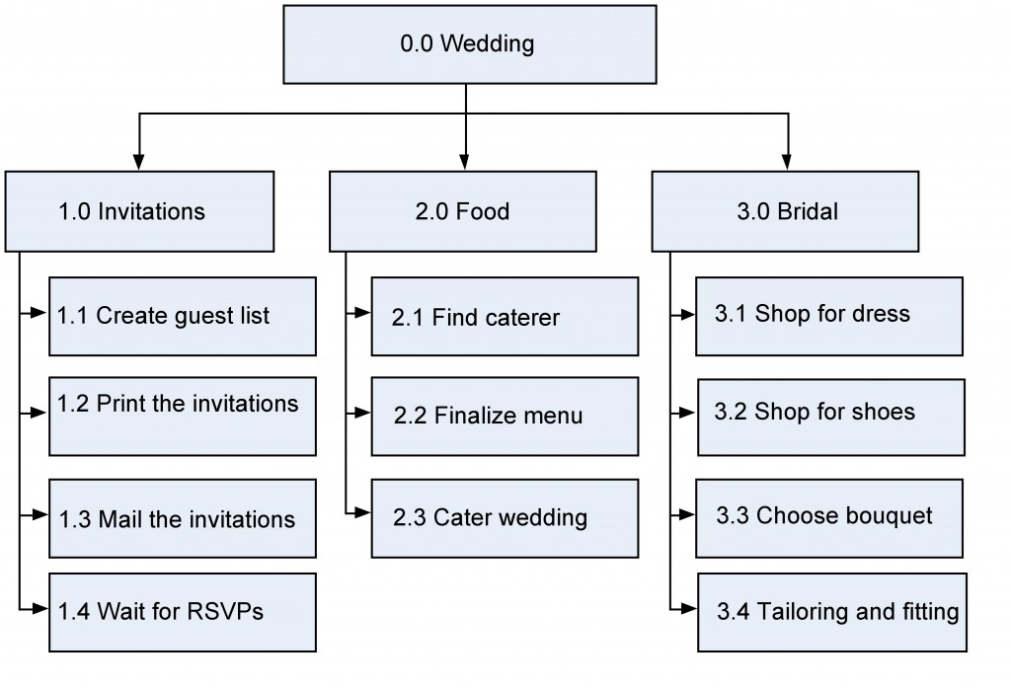

Slide 46
